Slide 1
ROLL OUT THE BARRELS
Angela Andrews
Monica Christopher
Leslie Raymer
Matthew Shively

Slide 7
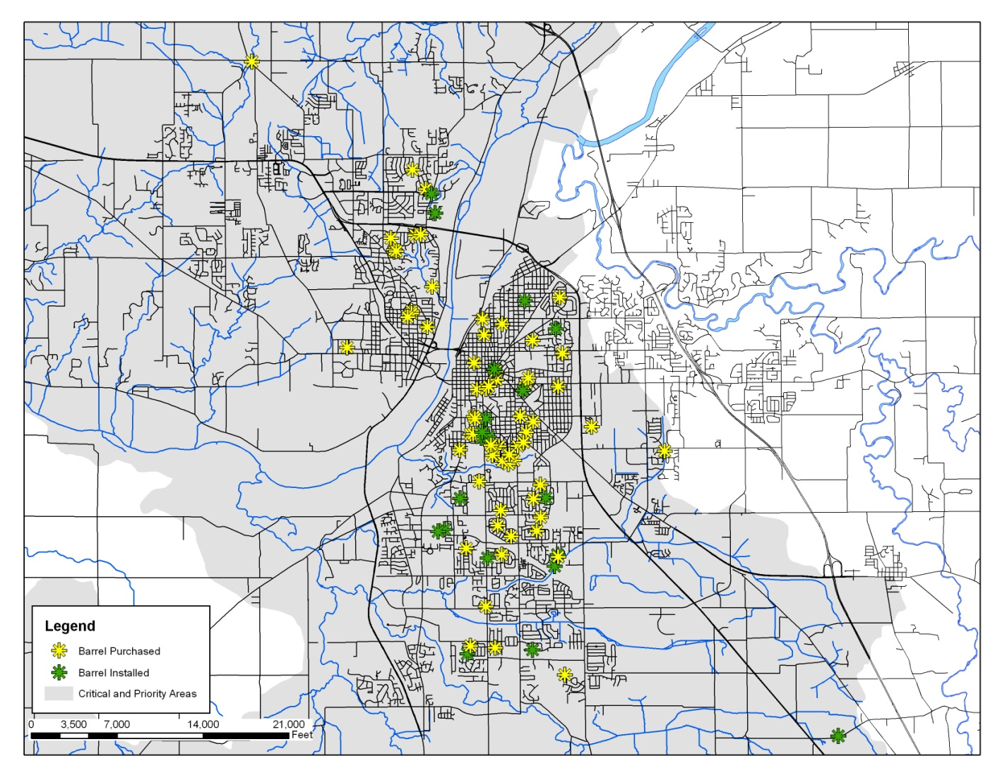
Barrel Locations

